Slide 1
YouthxHack 2024 Social Defence Theme Contextual Problem Statement Sharing
Chia Yi You, Cloud Native Strategist & Evangelist Cloud Native Architecture
31st Aug 2024

Slide 2
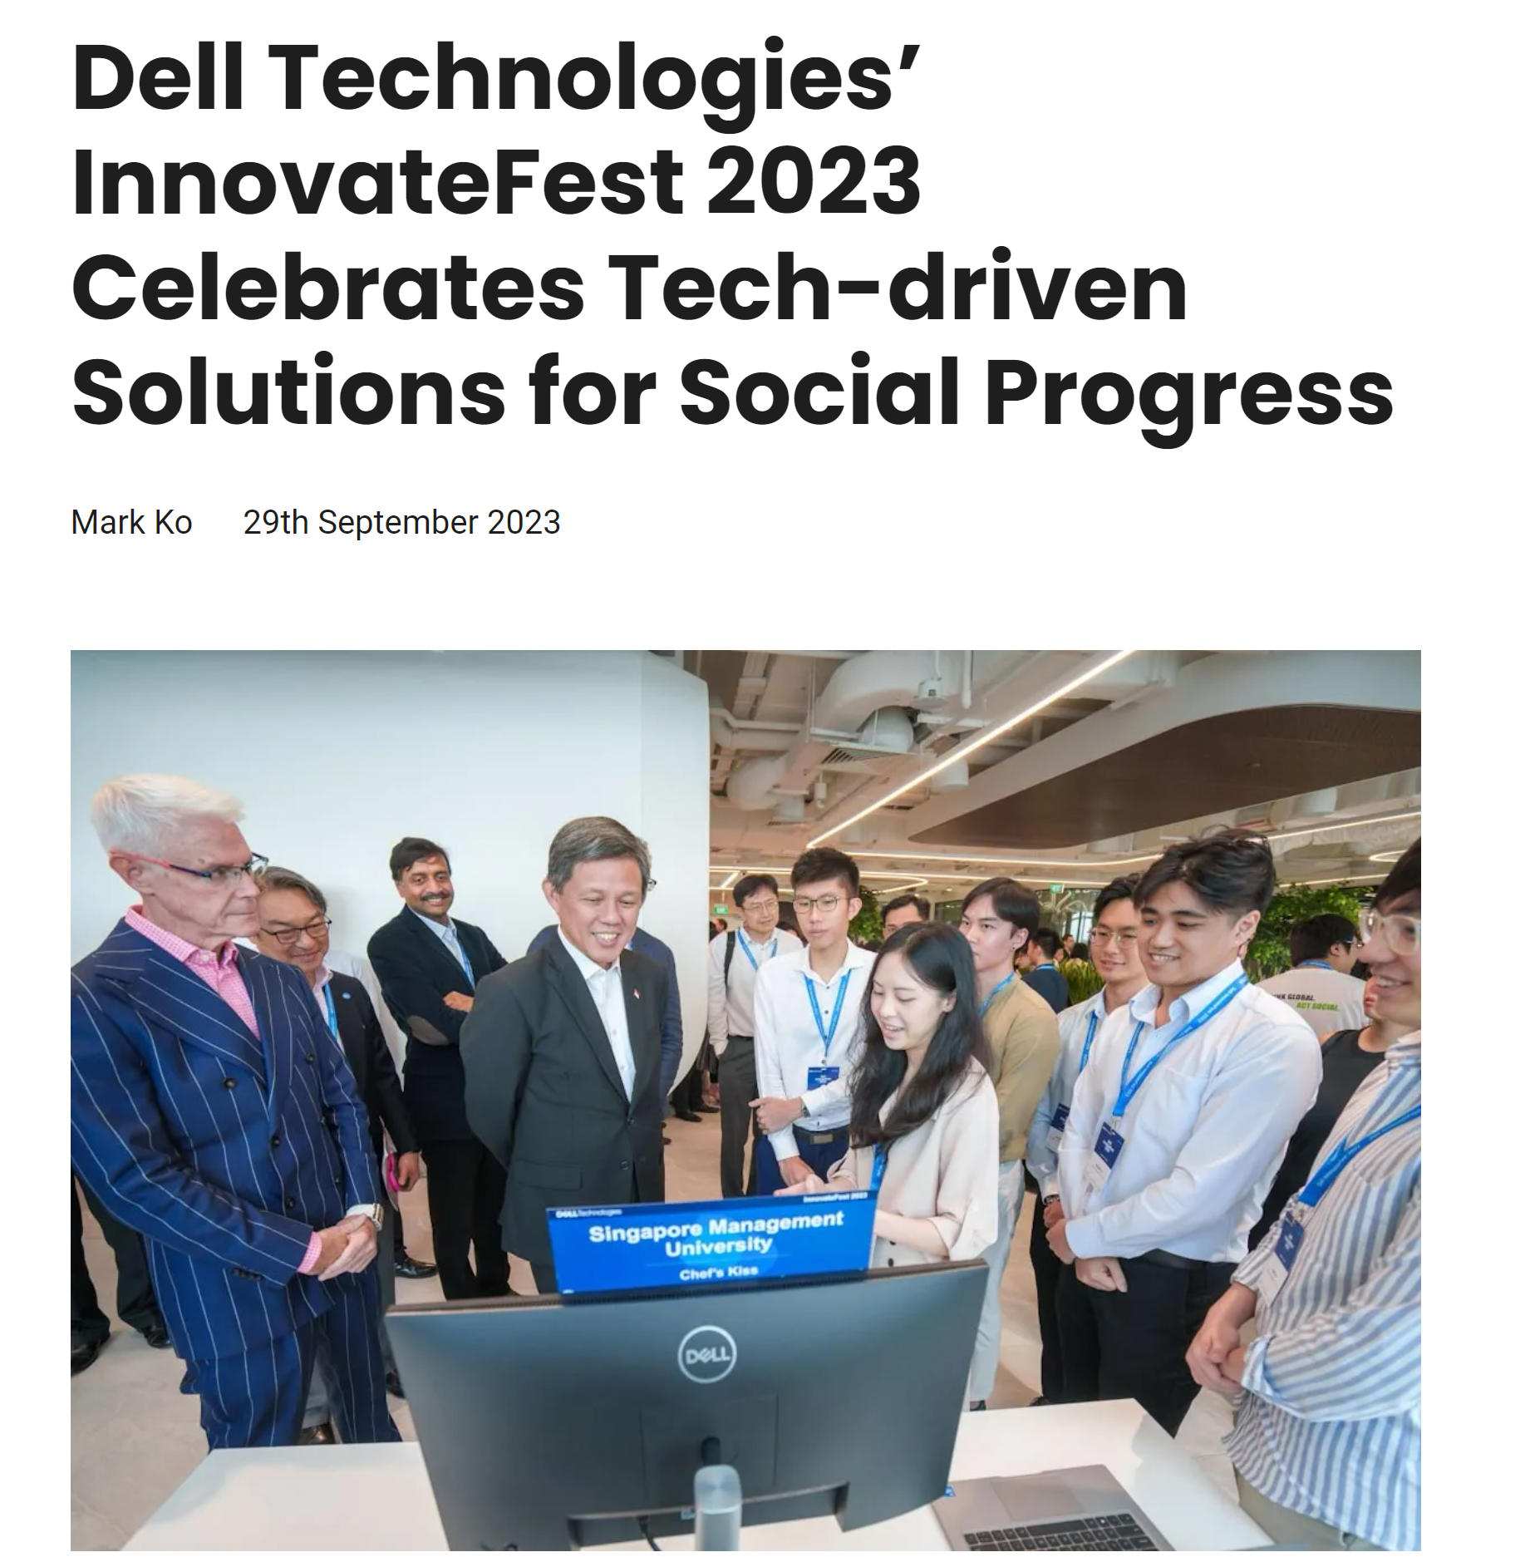
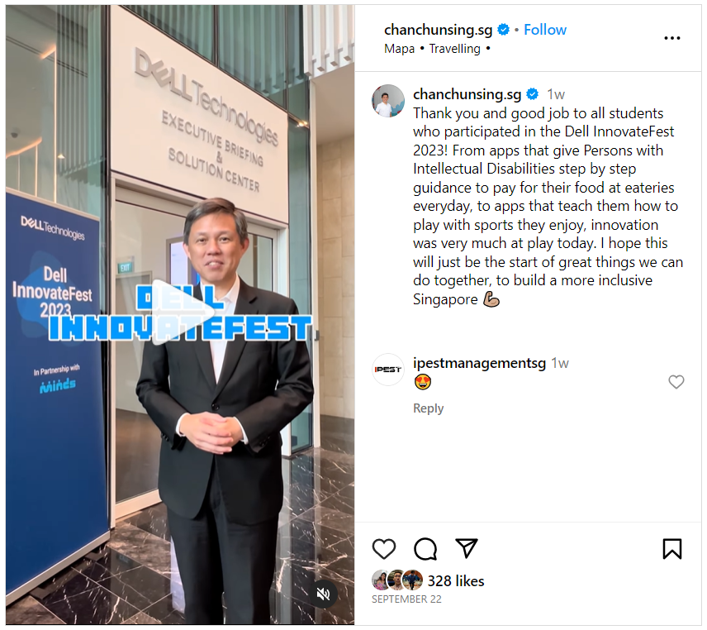

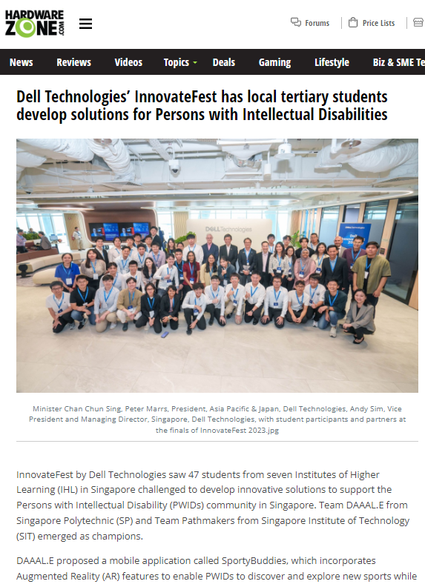
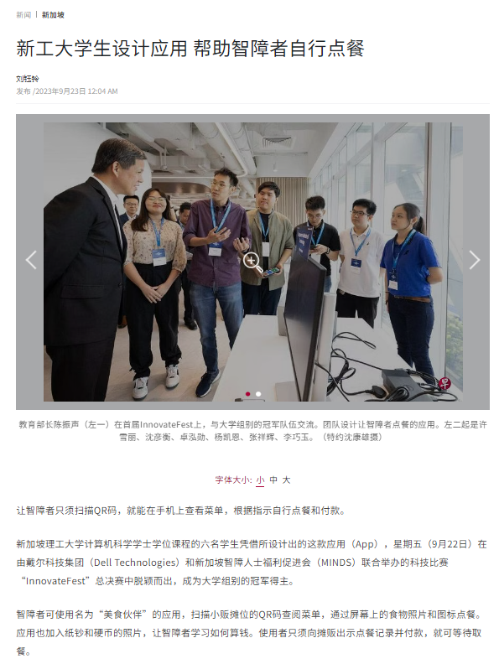
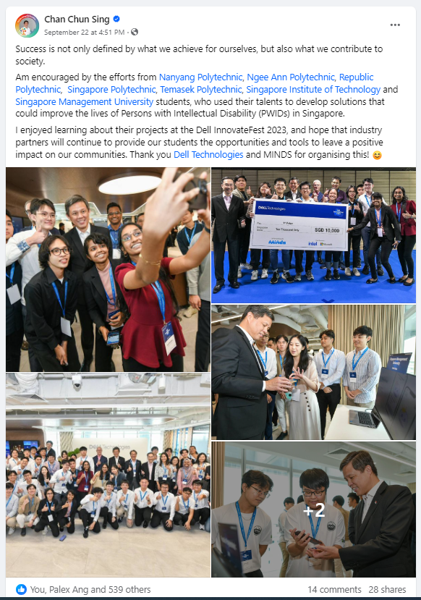
Dell’s Journey In Driving Social Progress
Dell’s IHL engagements and hackathons have been harnessing technology to drive social progress
Our Purpose: To create technologies that drive human progress
Dell InnovateFest - Hackathon with a Heart
Partnerships with SSA Lions Befrienders
Vulnerable Aged
Providing holistic care and support to help seniors age healthily
1,500 regular volunteers
Engages more than 7,800 seniors
Operates 10 Active Ageing Centres, two Community Case Management Services regions (East & West), two Senior Group Homes, Home Personal Care services, as well as a Befriending arm that reaches out to socially isolated seniors.
Do attend our Cloud Native & IHL Ecosystem Sharing on Day 3, 2 Sep, 10am at Auditorium 2!

Slide 3



Lions Befrienders Service Association (Singapore)
Presentation for YouthxHack 2024

Slide 4
Social Defence
"The bonds that unite us, built on trust and understanding among people of different races and religions, living in harmony and looking out for one another."
In a multiracial, multi-religious and multi-cultural society like Singapore, peace and progress is possible only if Singaporeans of all races and religions live together in harmony and look out for one another. It requires constant effort to build understanding and trust among different communities and to ensure that potential sources of misunderstanding and insensitivity are nipped in the bud quickly. This is Social Defence – everyone making an effort to trust one another and to strengthen the bonds across the different ethnic groups so that we are strong and united especially during times of national challenges.
How do you put Social Defence into action?
Looking out for and helping the less fortunate and underprivileged among us.
By being sensitive and respectful of other races in Singapore, and learning more about their traditions, cultures, religions, and heritage.
By befriending fellow citizens from other communities, and building strong bonds with them over common Singaporean experiences.
Show greater consideration and understanding to new citizens, helping them understand our way of life, and sharing with them different practices of different groups here.
Source: MINDEF

Slide 5
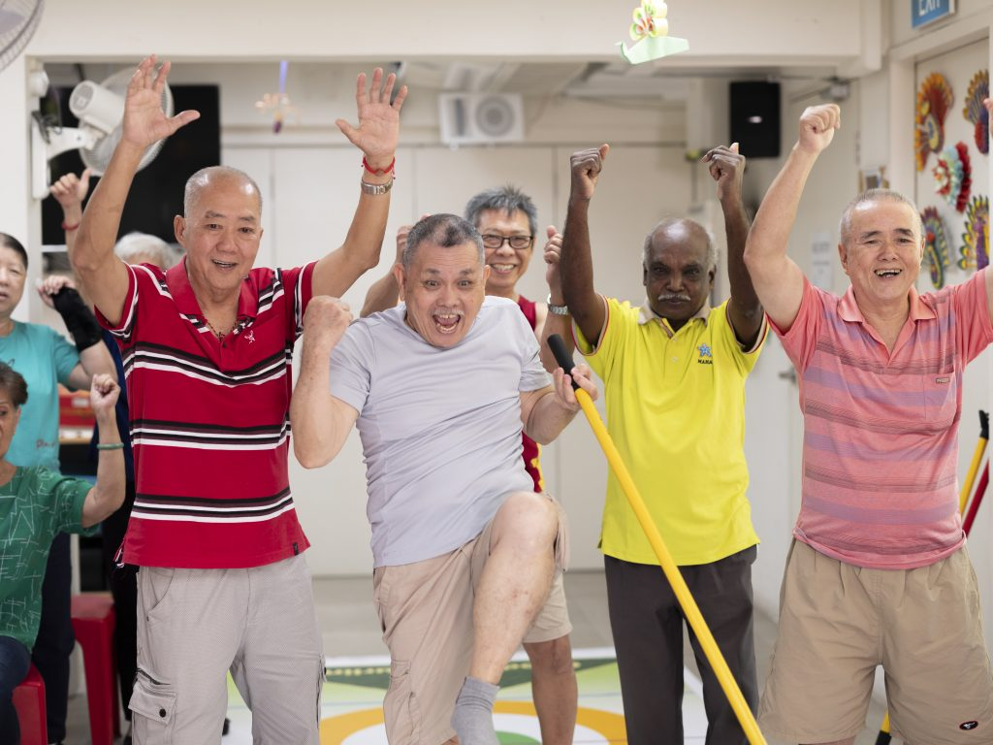
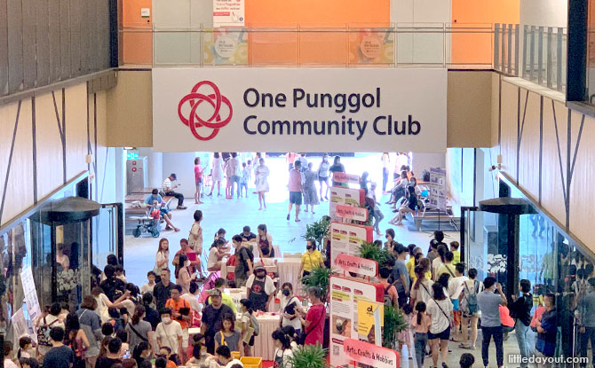
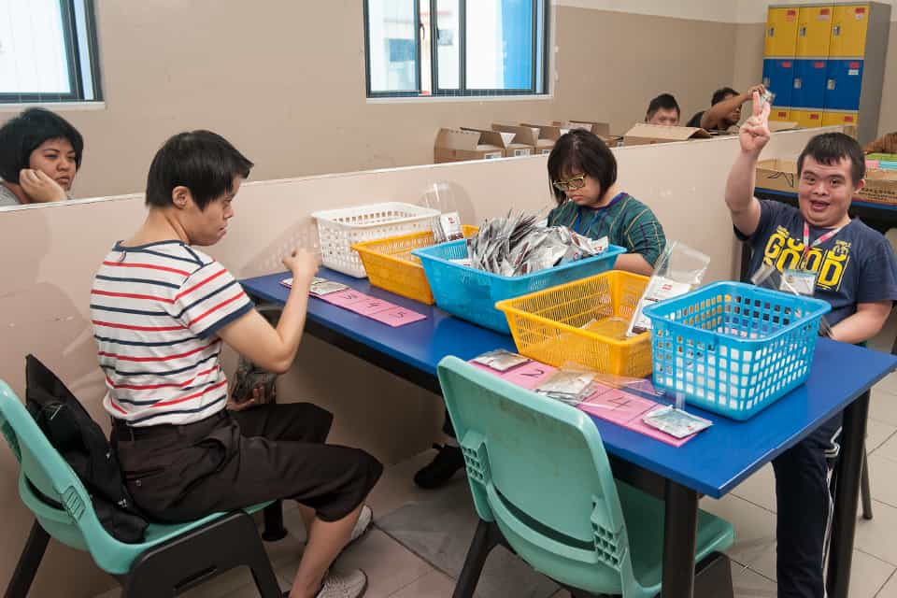
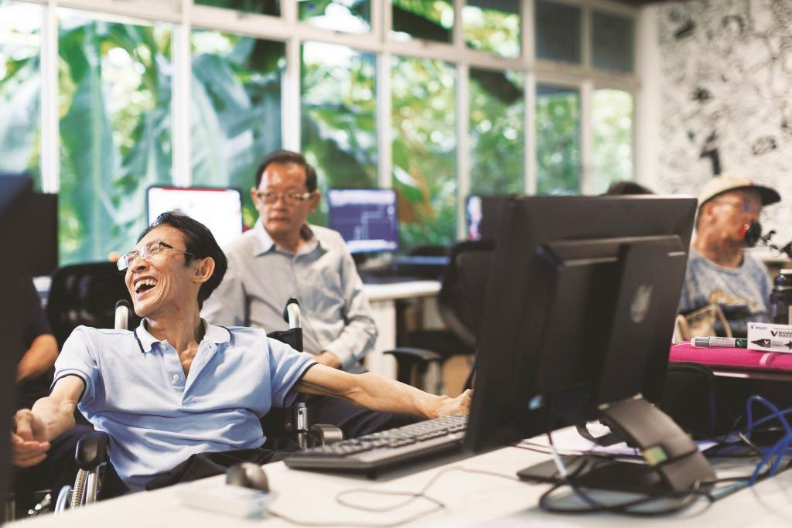
Problem Statement for Social Defence
Problem Statement Description
Vulnerable groups, including the elderly, low-income families and individuals with disabilities, often face difficulties in accessing community networks and interactions with the overall society. These community networks are platforms and/or spaces connecting vulnerable groups and stakeholders together to provide assistance, resources, access to key essential services, and/or companionship, ensuring their needs are met. Some examples include:
Active Ageing Centres
Community Clubs
MINDS Training & Development Centre
Enabling Village
For example, older seniors face language and physical barriers if they are unable to converse in the working language or are physically impaired. This results in challenges in joining community networks such as Active Ageing Centres, its related programmes, and interactions with others, affecting their access to support in key essential services (e.g., housing rights, finance, and government support) and well-being initiatives.
Problem Statement
How can we use technology to enable vulnerable groups to overcome language or physical barriers to access community networks, increasing and improving social interactions, especially during a crisis to empower them?
Source: Lions Befrienders, LittleDayOut, People’s Association, Movement for the Intellectually Disabled of Singapore (MINDS), SG Enable, Nexus

Slide 6
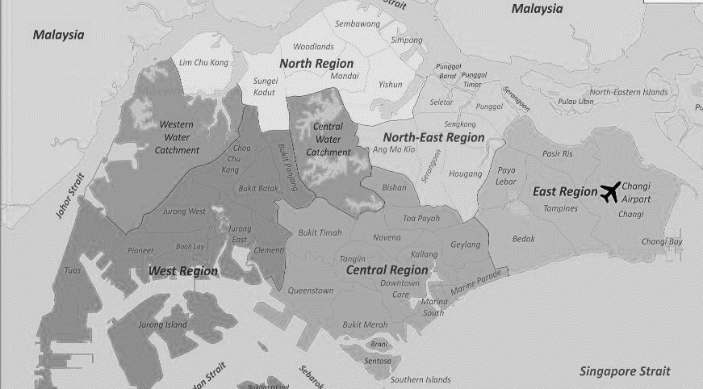

Meeting Community Needs with Our Programmes and Services
Region-Based Programmes
Building integrated community care networks to meet community needs.
Communities of Care (COC)
Mental Health Safe Pod
Health District @ Queenstown
Centre-Based Services
Empowering seniors to stay active and healthy with community participation.
Active Ageing Centre (AAC)
Home-Based Services
Enabling seniors to age well in place.
Befriending / Buddying
Community Case Management System (CCMS)
Home Personal Care (HPC)
Senior Group Home (SGH)
Counselling
Training and Development
Building capabilities for community care.
Lions Befrienders Training Centre
AAC @ Ang Mo Kio 318
Ang Mo Kio
AAC @ Clementi 420A
AAC @ Clementi 344
AAC @ Clementi 366
Tampines
Clementi
Bendemeer
AAC @ Tampines 434
AAC @ Tampines 499C
AAC @ Tampines 494E
CCMS @ Tampines / Changi
HPC @ Tampines
SGH @ Tampines
AAC @ Bendemeer 32
Queenstown
AAC @ Ghim Moh 18
AAC @ Mei Ling 150
COC @ Queenstown
Safe Pod @ Queenstown
CCMS @ Queenstown / Bukit Timah
HPC @ Queenstown
SGH @ Queenstown
Lions Befrienders Training Centre

Slide 7


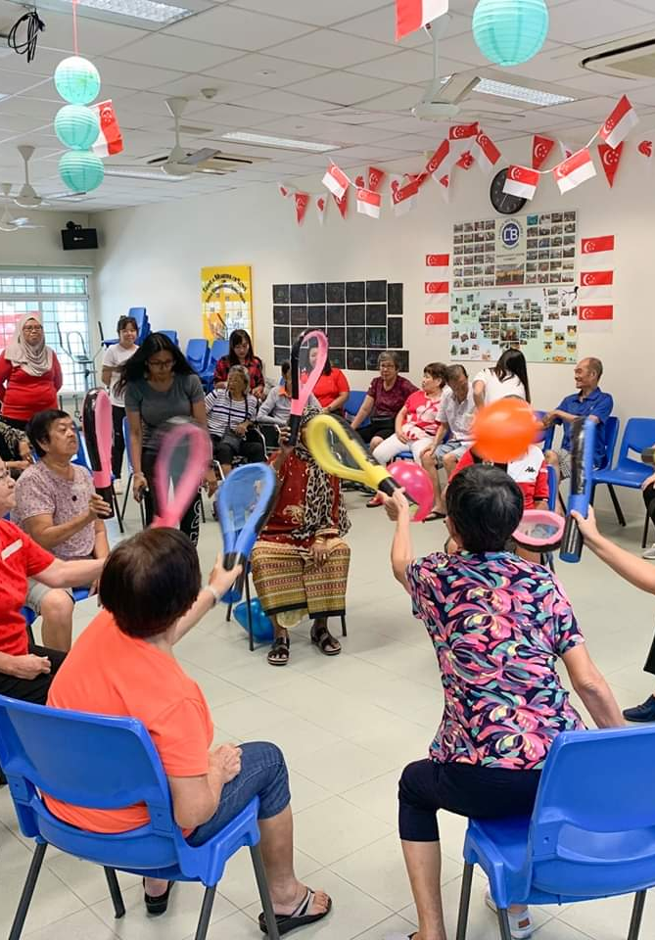

OUR CENTRE-BASED PROGRAMMES
Active Ageing Centres
Provides general social & health support to seniors
Promotes active ageing, continuous learning
Help seniors in their physical & mental alertness
Ensure they are supported by a relevant social, financial, medical, emotional and mental partners

Slide 8

Exercises, health talks, health screening, teleconsultation,
nurse post, TCM
Physical
Cognitive
Learning
5 Domains of AAC
Digital classes
New skills e.g.
Percussion, drumming, theatre, scam prevention
Art & music therapy, cognition-focused activities, mental health screening
Social
Volunteerism
Outings, festive celebrations, communal dining,
Befriending, check-in,
food delivery, organise events, outreach

Slide 9









Enhancing Community Care through Technology
LB’s Digital Transformation Strategy
Preventive & Early-stage Intervention Eldercare
Virtual Befriending
Smartphone Deployment
Telemedicine &
Teleconsultation
AI
(Screening)
IM-OK System (Monitoring)
IM-HEALTHY Station (Monitoring)
Ongoing Development
Exposing seniors to digital content & engagement.
Equipping seniors with tools to access digital content.
Promote easy monitoring & quick detection of change in health statuses.
Helping seniors seek medical help more safely and efficiently.
Screening of seniors’ negative emotions & mental health.
Empowering seniors to take ownership of their own well-being.
Improving current pilots & finding areas to innovate.
Outcomes
Strengthen LB’s Capability in Community Care
Change in Seniors’ Perception of Technology & Promotes Health-Seeking Behaviour

